Slide 1
INTERLIBRARY LENDING CONTACTS LIST
Inquiries from Non-Affiliated Patrons for UCB Materials
Shannon Monroe (Unit Head) - 510.643.6151
smonroe@library.berkeley.edu
Photoduplication Services (Worldwide) – 510.642.6956
illpmail@library.berkeley.edu
Lending Services (Worldwide)- 510.642.7367
lending@library.berkeley.edu
UC – UC/Stanford/UT-Austin Services – 510.642.5425
ill@library.berkeley.edu
Special Library Access (SLA Clients) – 510.642.6956
slareq@library.berkeley.edu
Research Library Cooperative Program (RLCP) – 510.642.5425
rlcp@library.berkeley.edu

Slide 2
INTERLIBRARY SERVICES
MAKING EFFECTIVE REFERRALS
INTERLIBRARY SERVICES
LENDING UNIT
UC BERKELEY
OCTOBER 2015
LENDING DIVISION
OCTOBER 2015

Slide 3
INTERLIBRARY SERVICES LENDING UNIT
DEPARTMENTAL COLLABORATIONS
SUBJECT SPECIALTY LIBRARIANS/CIRCULATION SUPERVISORS/SELECTORS/REFERENCE STAFF/ETC.
DIGITAL IMAGING LAB
PRESERVATION MICROFILM LAB
EAST RARE
ENVI RARE
BANCROFT SPECIAL COLLECTIONS
NRLF
EARTH SCIENCES & MAP LIBRARY
CSS-IT, LIBRARY SYSTEMS
LEGION OF ESSENTIAL & AWESOME LIBRARY COLLEAGUES, DIVISION HEADS, ETC.

Slide 4
LENDING UNIT - UC & SPECIAL AGREEMENT LIBRARIES (SAL) – WHO WE ARE
Mark Taylor (Supervisor)–UC/SAL
Barbara McEnerney – UC/SAL
Chun Meng Lin (Lynn) – UC/SAL
ill@library.berkeley.edu UC/SAL email

Slide 5
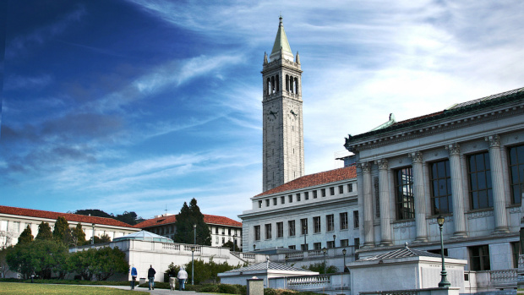
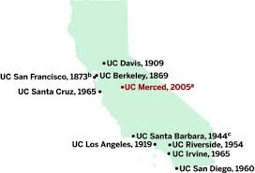
LENDING UNIT - UC & SPECIAL AGREEMENT LIBRARIES (SAL)
RECIPROCAL AGREEMENT FOR BORROWING AND LENDING FREE OF CHARGE BETWEEN UC BERKELEY AND ALL OTHER UC CAMPUSES

Slide 6
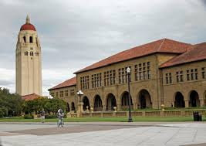
LENDING UNIT - UC & SPECIAL AGREEMENT LIBRARIES (SAL)
RECIPROCAL AGREEMENT FOR BORROWING AND LENDING FREE OF CHARGE BETWEEN UC BERKELEY AND STANFORD UNIVERSITY

Slide 7
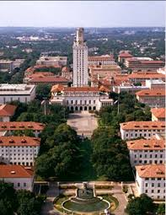
LENDING UNIT - UC & SPECIAL AGREEMENT LIBRARIES (SAL)
RECIPROCAL AGREEMENT FOR BORROWING AND LENDING FREE OF CHARGE AMONG UC BERKELEY AND UNIV OF TEXAS - AUSTIN

Slide 8
UC & SPECIAL AGREEMENT LIBRARIES (SAL)
REFERRALS FROM:
OTHER UC CAMPUSES-
ILL DEPARTMENTS/BRANCHES/AFFILIATES
STANFORD UNIVERSITY
UNIVERSITY OF TEXAS – AUSTIN
TO SUBMIT REQUESTS, PLEASE REFER PATRONS TO THEIR LOCAL UNITS
510-642-5425 ph.
ill@library.berkeley.edu UC/SAL email

Slide 9
UC & SPECIAL AGREEMENT LIBRARIES (SAL)
SERVICES
STANDARD AND EXPEDITED SERVICES
SCANS AND LOANS FREE OF CHARGE
SHIPPING VIA AUTHORIZED DAILY COURIER
REQUESTS RECEIVED – ONLINE ONLY
RENEWALS GRANTED – varies from 1-4 months

Slide 10
UC & SPECIAL AGREEMENT LIBRARIES (SAL)
SCANNING SERVICES
THESES & DISSERTATIONS
MICROFILM & MICROFICHE
MAPS (Consortium of UC Map librarians handle requests amongst themselves)
MONOGRAPHS & JOURNALS,
E-JOURNALS
RARE BOOKS AND OTHER MATERIALS

Slide 11
UC & SPECIAL AGREEMENT LIBRARIES (SAL)
MATERIALS WE LEND
MONOGRAPHS (up to single folio only)
THESES & DISSERTATIONS (circulating copy, restricted to Library Use Only and no duplication)
MICROFILM, MICROFICHE (non-archival, LUO)
NEWSPAPERS (on “NEWSFILM” only, LUO)
SELECT VHS/SOFTWARE/MEDIA AT OWNING UNIT’S DISCRETION

Slide 12
UC & SPECIAL AGREEMENT LIBRARIES (SAL)
MATERIALS WE DO NOT LEND
DOUBLE OR TRIPLE FOLIOS (Monographs)
THESES & DISSERTATIONS (308t, only remaining copy)
MICROCARDS
NEWSPAPERS
MAPS (UC Consortium policies)
RESERVES, REFERENCE, RARE, BUILDING USE ONLY
GOVERNMENT DOCS
CURRENT PERIODICALS, JOURNALS

Slide 13
RESEARCH LIBRARY COOPERATIVE PROGRAM (RLCP)
REFERRALS FROM:
UCB & Stanford faculty and graduate students are eligible for the program. Undergraduates and staff are not eligible for the program.
BENEFITS TO PROGRAM:
Stanford patrons request and receive UCB materials quickly and efficiently through unmediated requests or interlibrary loan.
Make in-person visits to either campus (UCB or Stanford), to access their library collections and check out material.

Slide 14
RESEARCH LIBRARY COOPERATIVE PROGRAM (RLCP)
Inquiries and Renewals from Stanford grad students and faculty for UCB materials are referred to: rlcp@library.berkeley.edu
Materials loaned are shipped via daily courier service among all UCs and Stanford University.
Longer loan periods through RLCP than if the patrons order through Interlibrary Services. Materials are checked out directly to the patron’s account, through the owning library’s circulation system.

Slide 15
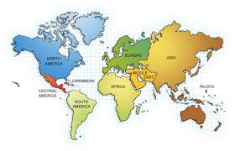
LENDING UNIT – NON-UC WHO WE ARE
Lisa Hong (Supervisor) – NON-UC
Teresa R. Moore (Terry) – NON-UC
Mary Hardy – NON-UC
Ryan Huertas – NON-UC
NON-AFFILIATED PATRONS/LIBRARIES
illpmail@library.berkeley.edu - PHOTODUPLICATION
lending@library.berkeley.edu - LOANS

Slide 16
NON-UC PHOTODUPLICATION
REFERRALS FROM:
PRIVATE & PUBLIC LIBRARIES
WORLDWIDE - PRIVATE INDIVIDUALS, RESEARCHERS, SCHOLARS, etc.
LAW FIRMS, CORPORATIONS, GOVERNMENT ENTITIES
INTERNATIONAL LIBRARIES
510-642-6956 ph.
illpmail@library.berkeley.edu PHOTO email

Slide 17
NON-UC PHOTODUPLICATION
SCANNING & DUPLICATION SERVICES
THESES & DISSERTATIONS
MICROFILM, MICROFICHE & MICROCARDS
MAPS
DIGITAL IMAGING LAB
PRESERVATION MICROFILM LAB
MONOGRAPHS & JOURNALS, E-JOURNALS
PHOTOGRAPHS, GLOSSY & MATTE PRINTS
NEGATIVES & SLIDES
RARE BOOKS AND OTHER MATERIALS
STANDARD AND EXPEDITED SERVICES (4-24hr turnaround)
REQUESTS RECEIVED – ONLINE via OCLC, WEBFORM

Slide 18
NON-UC LOANS
REFERRALS FROM:
DOMESTIC PUBLIC, INSTITUTIONAL, CORPORATE & PRIVATE LIBRARIES
INTERNATIONAL INSTITUTIONAL LIBRARIES (Australia, China, Japan, Europe, etc.)
510-642-7367 ph.
lending@library.berkeley.edu LOANS email

Slide 19
NON-UC LOANS
SERVICES
STANDARD AND EXPEDITED SERVICES
FREE FOR ALL CALIFORNIA PUBLIC LIBRARIES
SHIPPING VIA AUTHORIZED COURIER (UPS, FEDEX, etc.)
RENEWALS GRANTED – 2 weeks; case by case
REQUESTS RECEIVED – ONLINE via OCLC, WEB-FORM

Slide 20
NON-UC LOANS
MATERIALS WE LEND
MONOGRAPHS (up to single folio only)
THESES & DISSERTATIONS (circulating copy, restricted to Library Use Only and no duplication)
MICROFILM (non-archival, LUO)
NEWSPAPERS (on “NEWSFILM” only, LUO)

Slide 21
NON-UC LOANS
MATERIALS WE DO NOT LEND
DOUBLE OR TRIPLE FOLIOS (Monographs)
THESES & DISSERTATIONS
(308t, only remaining copy)
MICROFILM (archival)
NEWSPAPERS
MAPS
RESERVES, REFERENCE, RARE, BUILDING USE ONLY
AUDIO/VISUAL, MEDIA, GOVERNMENT DOCS, SOFTWARE
CURRENT & PRECEDING YEAR IMPRINTS; CURRENT PERIODICALS, JOURNALS

Slide 22
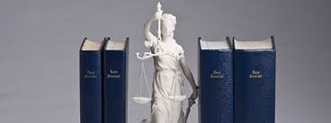
SPECIAL LIBRARY ACCESS (SLA)
REFERRALS FROM:
FEE-BASED SUBSCRIBERS – CORPORATE, LAW LIBRARIES, INFORMATION CENTERS, ETC.
DEPOSIT ACCOUNTS
WEB-FORM REQUESTS ONLY; RENEWALS GRANTED
EXPEDITED SERVICE (4-48 hr turnaround)
SCANNING AND LENDING OF RETURNABLES
BOALT EXPRESS HAS CLOSED, SO PLEASE REFER ANY LAW FIRM INQUIRIES TO SLA
Terry Moore
510-642-6956 ph.
slareq@library.berkeley.edu email

Slide 24
ILL EXTRAS
We recall materials, send overdue & billing notices; email us with any questions!
Refer all procedural questions & non-affiliated patrons to us.
If you have time, direct non-affiliated patrons to our departmental emails & websites.
Thanks to all of the owning unit librarians and staff, because without your support and consent to let us loan and scan, we could not support borrowing for UCB patrons!
“You have our book, we have your son. Please return immediately.”

Slide 25
HOW TO FIND US!

Slide 27
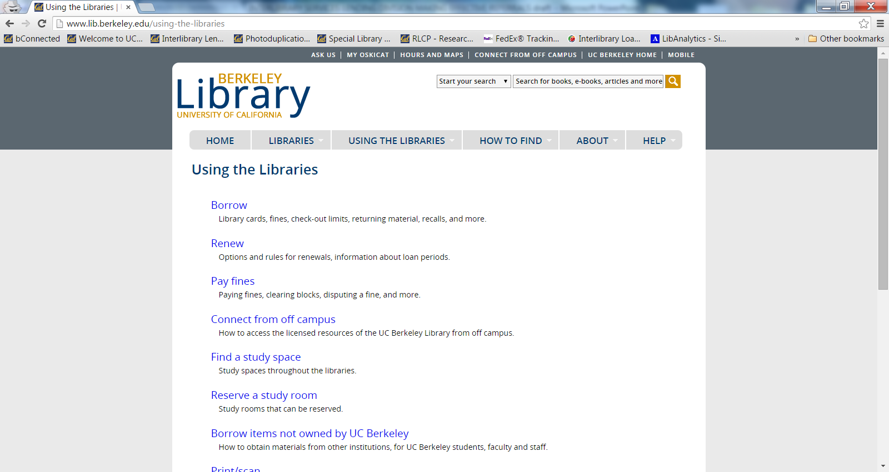

Slide 28
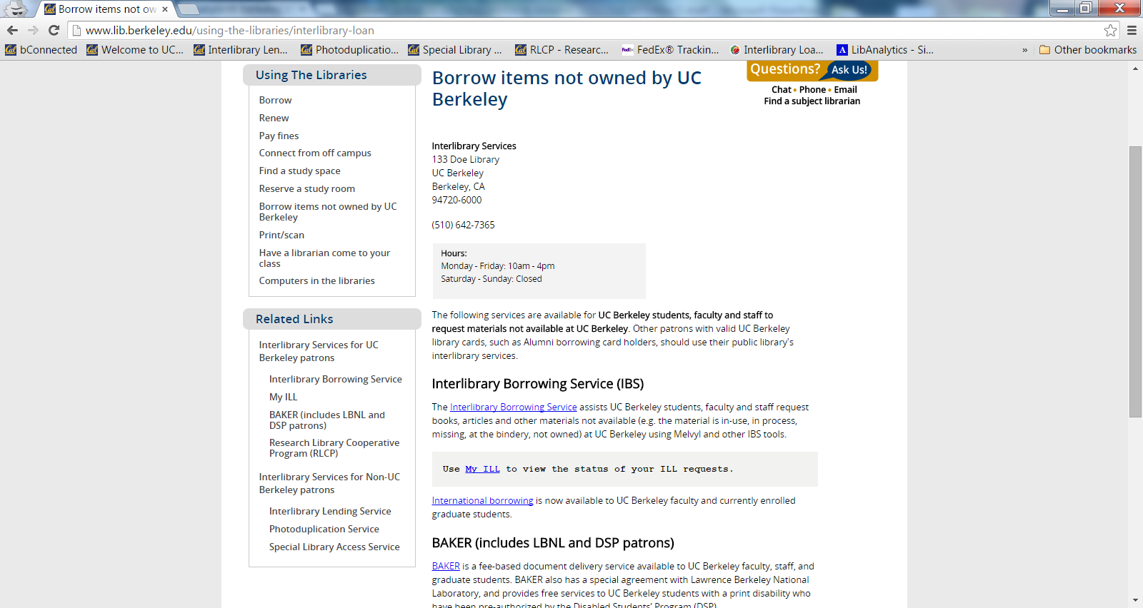

Slide 29
HOW TO FIND US
GO TO: UCB LIBRARY HOME PAGE
USING THE LIBRARIES
BORROW ITEMS NOT OWNED BY UCB (a bit of a labyrinthine route, but keep going, trust us!)
SCROLL DOWN & LOOK LEFT TO RELATED LINKS
FIND LINK FOR WEBSITE FOR SERVICE NEEDED (ILL, Resource Sharing, Document Delivery, etc., are industry-standard terms you may encounter)

Slide 30
HOW TO FIND US CONT’D
5. (Repeat steps 1-4)
INTERLIBRARY LENDING SERVICE –
NON-UC AFFILIATED LOAN INQUIRIES
ILL LENDING WEBSITE
Request form: ILL request form

Slide 31
HOW TO FIND US CONT’D
INTERLIBRARY LENDING SERVICE
LISA HONG, TERRY MOORE,
MARY HARDY & RYAN HUERTAS
510-642-7367 ph.
lending@library.berkeley.edu

Slide 32
HOW TO FIND US CONT’D
6. (Repeat steps 1-4)
PHOTODUPLICATION SERVICE –
NON-UC AFFILIATED SCANNING INQUIRIES
ILL PHOTODUPLICATION WEBSITE
Request form: Photoduplication Request Form

Slide 33
HOW TO FIND US CONT’D
PHOTODUPLICATION SERVICE
LISA HONG, TERRY MOORE,
MARY HARDY & RYAN HUERTAS
510-642-6956 ph.
illpmail@library.berkeley.edu

Slide 34
HOW TO FIND US CONT’D
7. (Repeat steps 1-4)
SPECIAL LIBRARY ACCESS (SLA) –
NON-UC AFFILIATED CORPORATE LIBRARIES
SPECIAL LIBRARY ACCESS (SLA) WEBSITE
Request form: Web form

Slide 35
HOW TO FIND US CONT’D
SPECIAL LIBRARY ACCESS (SLA)
NON-UC AFFILIATED CORPORATE LIBRARIES
TERRY MOORE
510-642-6956 ph.
slareq@library.berkeley.edu

Slide 36
HOW TO FIND US CONT’D
8. (Repeat steps 1-4)
RESEARCH LIBRARY COOPERATIVE PROGRAM (RLCP) - UCB & STANFORD PATRONS
RESEARCH LIBRARY COOPERATIVE PROGRAM (RLCP) WEBSITE
Request form: RLCP online request form

Slide 37
HOW TO FIND US CONT’D
RESEARCH LIBRARY COOPERATIVE PROGRAM (RLCP) - UCB & STANFORD PATRONS
MARK TAYLOR
510-642-5425 ph.
Rlcp@library.berkeley.edu

Slide 38
HOW TO FIND US CONT’D
UC & SAL
UC – to – UC, Stanford & UT-Austin Loans and Scanning Inquiries
MARK TAYLOR, BARBARA MCENERNEY, CHUN MENG LIN
510-642-5425 ph.
ill@library.berkeley.edu

Slide 39
IF ALL ELSE FAILS…

Slide 40
SEND INQUIRIES TO:
SHANNON MONROE
UNIT HEAD - LENDING/PHOTODUPLICATION
510-643-6151 ph.
smonroe@library.berkeley.edu

Slide 41
NEXT STEPS
SEND FOLLOW UP QUESTIONS; BOOKMARK OUR WEBSITES; PRESENTATION AVAILABLE VIA EMAIL
INTERLIBRARY SERVICES LENDING UNIT LIBGUIDE; SOCIAL MEDIA AWARENESS

